Slide 1
FAKE NEWS DETECTION A Machine Learning Approach
VADDADI VENKATESH
G SINDHU
G MOHAN KRISHNA

Slide 2
Fake News
Fake news is a type of yellow journalism or propaganda that consists of deliberate misinformation or hoaxes spread via traditional print and broadcast news media or online social media.
Fake news is written and published with the intent to mislead in order to damage an agency, entity, or person, and/or gain financially or politically, often with sensationalist, exaggerated, or patently false headlines that grab attention
Fake news often employs eye-catching headlines or entirely fabricated news stories to increase readership, online sharing and Internet click revenue

Slide 3
Problem Statement - Approach
Design an algorithm that can automatically detect fake news with reasonable accuracy
We would like to view it as a Classification problem in Machine Learning
Because the underlying problem here is to classify the given news item as either Authentic or Fake
Also Machine Learning is rich in theory, algorithms, etc.; which can be exploited to arrive at a solution

Slide 4
Algorithm - Overview
Training Phase:
Collect several news items that include legitimate as well as manufactured ones. This becomes the training data set.
Associated with every news item, create a feature vector consisting of the scores of the parameters (see slide no. )
Run a Clustering algorithm with two clusters namely the Fake and the Authentic.
Fine tune the scores associated with the parameters of the feature vector so that the clustering algorithm gives correct solution for the training data set

Slide 5
Algorithm – Overview Contd..
Prediction Phase:
Collect the news item that needs to be classified.
Create the feature vector using the scores of the parameters
Find the distances of the feature vector with the centroids of the clusters corresponding to both the clusters created using training data.
Identify the news item as Fake if the corresponding feature vector is close to the centroid of the cluster corresponding to Fake News; Otherwise identify it as an Authentic news item.

Slide 6
Algorithm – Overview Contd..
After some time, ascertain whether the classification done by the algorithm is correct or not.
Use this information either to strengthen or to fine tune the scores of the parameters in the database.
The algorithm can be made more sophisticated by taking the context into account; this in turn suggests creating a data base consisting of conditional probabilities and the concerned scores of the parameters.

Slide 7
Feature Vector
Following are some of the parameters that could be considered for a feature vector
Origin of the news, (TV channels, print media, whatsapp, etc.)News made by, News about whom,
Type of news (paid news, editorial news, featured article, etc.), Keywords in the news,
Category of the news (political, sports, etc.), Region that gets impacted, Sensitivity of the news, Positive news or negative news
Context (parameters that describe the context)

Slide 8
Bot
An Internet bot, also known as web robot, WWW robot or simply bot, is a software application that runs automated tasks (scripts) over the Internet
Typically, bots perform tasks that are both simple and structurally repetitive, at a much higher rate than would be possible for a human alone

Slide 9
BOT DETECTION and AUTHENTICATION
BOT DETECTION
Approach similar to Fake news detection would be employed.
But with an emphasis on repetition of the words, phrases, actions, etc.
ALGORITHM:
Every news that found to be more probably fake is analyzed as follows:
Source(from whom the publisher got the news).
Publisher(who is publishing the news).
Time
We are traversing back through the source with time parameter and analyze the publishers of source and declare the source as a bot.
AUTHENTICATION
From the statistic analysis of the result of clustering algorithm for all the news spread by a source who has high fake probability then we declare source as not authentic.

Slide 10
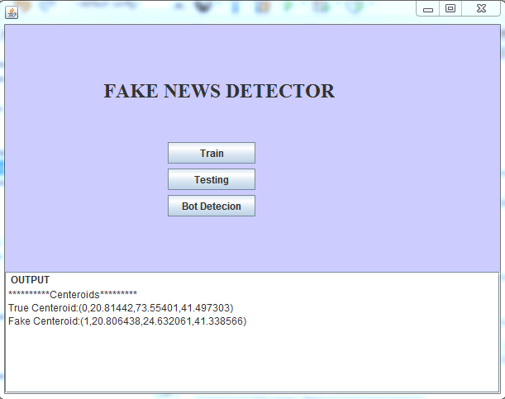
IMPLEMENTATION
TRAINING
PHASE

Slide 11
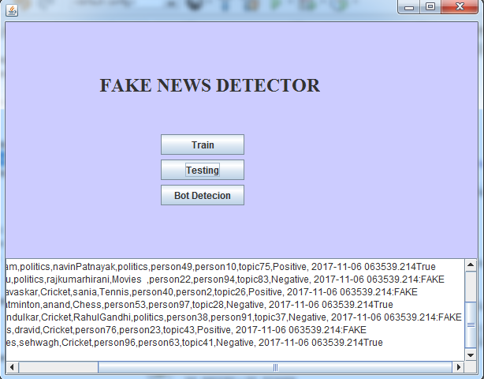
Contd…
TESTING
PHASE

Slide 12
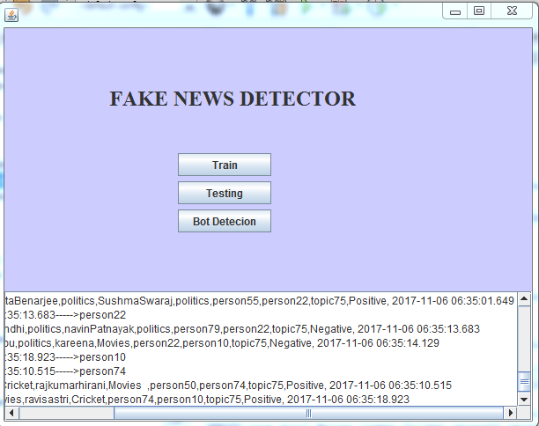
Contd..
BOT
DETECTION

Slide 13
CONCLUSION
Now-a- days more people are showing interest towards social news media than traditional news media which has been used for spreading fake news which has strong negative impacts on individuals and broader society. So we are giving some probability that news can be a fake news and its source. So they can assume that this might be a fake before considering it
We can extend this by adding conditional probability in assigning values to feature vector.

